Slide 1

SAGE: Student Academic for Growth and Education
SOA Project Review-3
Date& Time
 | Under the Guidance of Dr.Venkateshwari mam Assistant Professor, Department of Computer Science and Engineering, KLH CSE Bowrampet Campus
Team Members Name Roll Number

Slide 2
Outline of Project Work
Focus
Introduction
Literature Survey
Challenges
Research Objectives
Conclusion & Future Work
References
Publications Details

Slide 3
Problem Statement
Students have their academic responsibilities, coding activities, goals, schedules, deadlines, and reminders scattered across multiple platforms. The real difficulty is not just tracking these things, but deciding what to work on at a particular time and adapting when plans change.
Problem | What happens to students
Fragmentation | Assignments, exams, calendars, coding contests, goals, etc. live in different places
Poor prioritization | Students know what is pending but don't know what deserves attention now
Deadline/reminder overload | Important events can be missed or reminders become noisy
Static planning | A timetable doesn't automatically adapt when tasks are postponed or priorities change
No learning from behavior | Existing tools generally don't use patterns like postponing tasks or preferred study times to improve future planning

Slide 4
Objectives
The objective of SAGE is to help students manage fragmented academic and personal commitments by providing personalized prioritization, adaptive planning, timely reminders, and progress-based recommendations in one unified platform.
Centralize student activities
Bring tasks, goals, academic schedules, exams, coding contests, and other commitments into one platform.
Provide intelligent prioritization
Help students determine what they should focus on right now based on urgency, deadlines, available time, and commitments.
Enable personalized planning
Use the student's preferences, daily study target, focus rhythm, and availability to create a more suitable work schedule.
Provide timely reminders
Notify students about important tasks, exams, goals, and coding contests through appropriate channels such as in-app and email notifications.
Adapt to changing plans
Allow students to reschedule, postpone, snooze, or complete tasks while keeping the plan updated accordingly.

Slide 5
Literature Survey
Authors | Title of the Paper | Methodology | Inferences | Limitation/Future work
Dragoni et al. [1] | Microservices: Yesterday, Today, and Tomorrow, Springer, 2017 | Literature review and architectural analysis of the evolution from SOA to microservices | Establishes microservices as an architectural style inspired by service-oriented computing; identifies core traits: independent deployability, per-service data ownership, and decentralized governance | Primarily conceptual; does not evaluate a working implementation or provide empirical performance benchmarks
Harshitha et al. [2] | Architecting Event-Driven Microservices: Unlocking Asynchronous Communication with Kafka and RabbitMQ, 2025 | Comparative survey of Apache Kafka and RabbitMQ for asynchronous inter-service communication in microservice systems | Kafka provides high-throughput, distributed event streaming well suited to real-time, loosely coupled service communication such as deadline and digest events | Does not address service decomposition granularity or LLM-driven consumers of the event stream
Sundrababu et al. [3] | Student Learning Assistant Based on Adaptive LLM, IJERT, 2026 | Web-based adaptive LLM assistant offering individualized academic support and auto-generated assessments from syllabus content | Demonstrates that LLMs can personalize academic guidance per student, improving on one-size-fits-all learning platforms | Focused on tutoring/assessment generation rather than calendar-driven task prioritization or event-driven system design

Slide 6
Problem Gap Identification
Key gaps
Fragmented information
  Academic tasks, calendars, exams, coding contests, goals, and reminders are often managed through separate platforms.
  Students have to manually combine this information to understand their overall workload.
Tracking without intelligent prioritization
  Conventional task and calendar applications show what is pending.
  They generally do not provide a unified, context-aware answer to “What should I focus on right now?”
Static planning
  Traditional schedules are usually created once.
  When a student postpones a task, misses a study session, or receives a new deadline, the plan may require manual restructuring.
Limited personalization
  Generic productivity tools may not sufficiently account for individual factors such as preferred study time, daily study targets, focus-session preferences, and workload.
Disconnected coding-contest information
  Students who participate in multiple coding platforms may need to check different sources for upcoming contests.
  A unified contest view with personalized platform selection and reminders addresses this gap.
Reminder overload or missed reminders
  Students may receive reminders without considering their actual schedule and priorities.
  There is a need for reminders that are connected to the student's tasks, deadlines, contests, and preferences.

Slide 7
Innovation, Creativity, and Novelty
• Career-aware prioritization: SAGE ranks tasks not just by due date but by grade weight and alignment with the student's stated career goal.
• Dual-LLM resilience design: a free cloud LLM (Groq) serves as the primary reasoning engine, with an automatic, zero-cost local fallback (Ollama) triggered via a Resilience4j circuit breaker.
• Fully event-driven core: deadline detection, digest generation, and notification delivery are decoupled through Kafka rather than tightly coupled synchronous calls.
• Zero-cost architecture: every component — service discovery, messaging, caching, observability, and the LLM itself — runs on free-tier or self-hosted infrastructure.
• Transparent AI reasoning: every generated priority includes a plain-language rationale, so the student sees why a task was ranked highly, not just what to do.

Slide 8
Feasibility and Project Plan
All core components — Spring Boot, Spring Cloud, Kafka, PostgreSQL, Redis, and Docker — are open-source and self-hosted at zero cost. The Groq API and a local Ollama fallback eliminate LLM subscription fees, and the Google Calendar API and Gmail SMTP operate free within their standard quotas. The project is scoped to a single, demonstrable core loop — calendar deadline to AI-generated digest to notification — making it feasible to build end-to-end within a four-week academic timeline.
Phase | Duration | Key Deliverable
1. Architecture Foundation | Week 1 | Eureka Server, Config Server, and API Gateway running; landing page built
2. Identity & Data Services | Week 2 | Google OAuth2 login; Calendar Ingestion and Profile services live with real data
3. Intelligence Core | Week 3 | Kafka event bus wired; SAGE Brain generating real AI-driven priority digests
4. Delivery & Reliability | Week 4 | Notification delivery, Resilience4j fallback, full observability stack, final demo

Slide 9
Dataset and Data Sources (1 of 2)
SAGE does not use a traditional static ML training dataset — it reasons over the student's own live planning data, collected from multiple sources.
Data source | What is captured | What SAGE uses it for
Task Data | Task title · deadline · effort estimate · importance · status · snooze count | Backbone of the daily plan — priority ranking, time-block sizing and snooze-pattern detection
Recurring Goals | DSA practice · online courses · personal learning goals · daily and weekly practice targets | Auto-injected into every future plan without the student re-entering them
Google Calendar Data | Classes · labs · exams · other fixed commitments | Computes the student's real available study time

Slide 10
Dataset and Data Sources (2 of 2)
Data source | What is captured | What SAGE uses it for
Codeforces Data | Upcoming contests · contest start time · contest duration · contest information | Injected into the plan as fixed-time events that cannot be moved
Student Behaviour Data | Completed tasks · skipped tasks · snoozed tasks · repeated snoozes | The system's only learning signal — drives adaptive rescheduling and the snooze-pattern trigger
The PRD defines tasks, recurring goals, Google Calendar events and Codeforces contests as the core inputs to SAGE; behaviour data is what makes the plan adapt over time.

Slide 11
Methodology (1 of 2)
Step 1 — Authentication
– Student logs in using Google OAuth2.
– Auth Service handles authentication and issues a JWT.
– API Gateway validates every request.
Step 3. Data Integration
Information from different sources is brought together into a unified student context.
Step 2 — Data Collection
User Data Collection
SAGE first collects relevant student information such as:
Tasks and assignments
Goals
Deadlines
Academic schedule
Exams
Coding-contest preferences
Daily study target
Preferred focus time
Notification preferences
Step 4 . Context Analysis
SAGE analyzes the student's current situation using factors such as:
Deadline proximity
Task priority
Estimated duration
Available time
Existing commitments
Daily study target
User preferences

Slide 12
Methodology (2 of 2)
Step 5.Personalized Scheduling
Based on the student's preferences and available time, SAGE creates or adjusts a suitable work schedule.
For example:
If a student has a 3-hour daily target and prefers evening study, SAGE allocates appropriate focus sessions during that period.
7. Behavioral Feedback
SAGE records interactions such as:
Task completed
Task postponed
Task snoozed
Task rescheduled
Goal completed
This creates a feedback loop.
6. Action & Reminders
The student can then:
Start a task
Complete it
Snooze it
Reschedule it
Change its priority
SAGE can generate reminders for important tasks, exams, goals, and coding contests.
8. Continuous Adaptation
When circumstances change, SAGE updates the plan instead of relying on a completely static timetable.

Slide 13
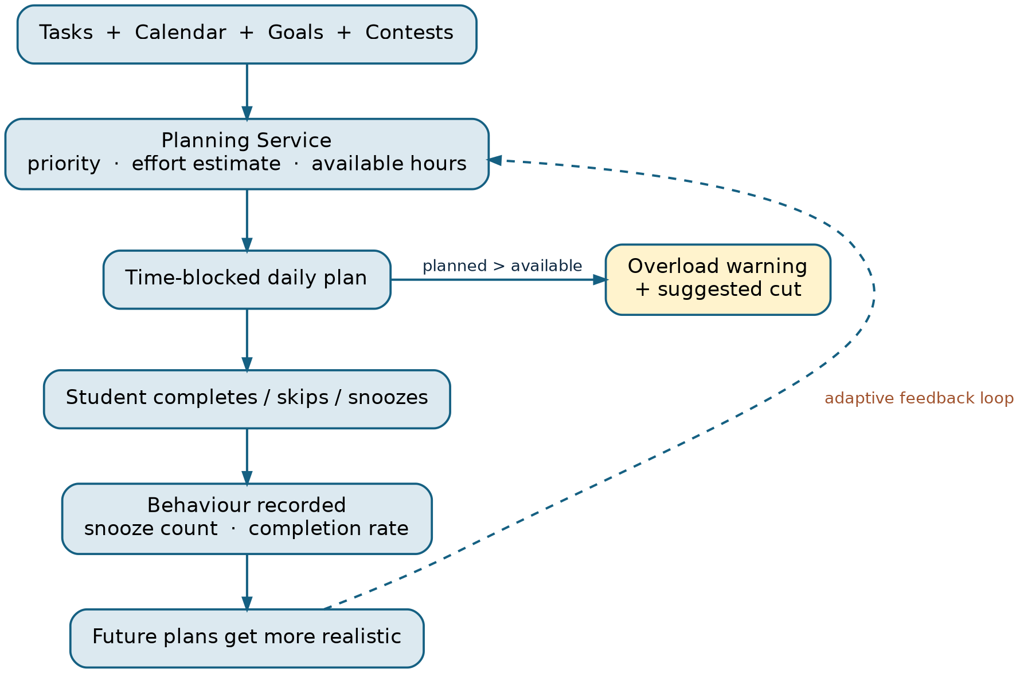
Core Product Loop
Figure 2 — The adaptive loop is the project's central product and technical claim; every other feature exists to feed or surface it.

Slide 14
System Architecture — Microservices
Service | Responsibility | Database | Status
Auth Service | Google OAuth2, JWT issuance, role-based authorisation | auth_db | Already built
Task Service | Task CRUD, recurring goals, status, snooze count | task_db | To build
Integration Service | Pluggable Contest / Profile Provider architecture (Codeforces live, others stubbed) plus Google Calendar sync | integration_db (cache only) | To build
Planning Service (SAGE Brain) | Today's schedule, overload detection, adaptive rescheduling, LLM Q&A | planning_db | To build
Notification Service | Event-triggered contest, task and goal reminders; snooze nudges | notification_db (or stateless) | To build
Why exactly five: each owns a distinct responsibility, data shape and failure mode — transactional CRUD, third-party isolation behind one interface, the only LLM-dependent decision component, and pure event-driven dispatch. No service was added to hit a requirement count.

Slide 15
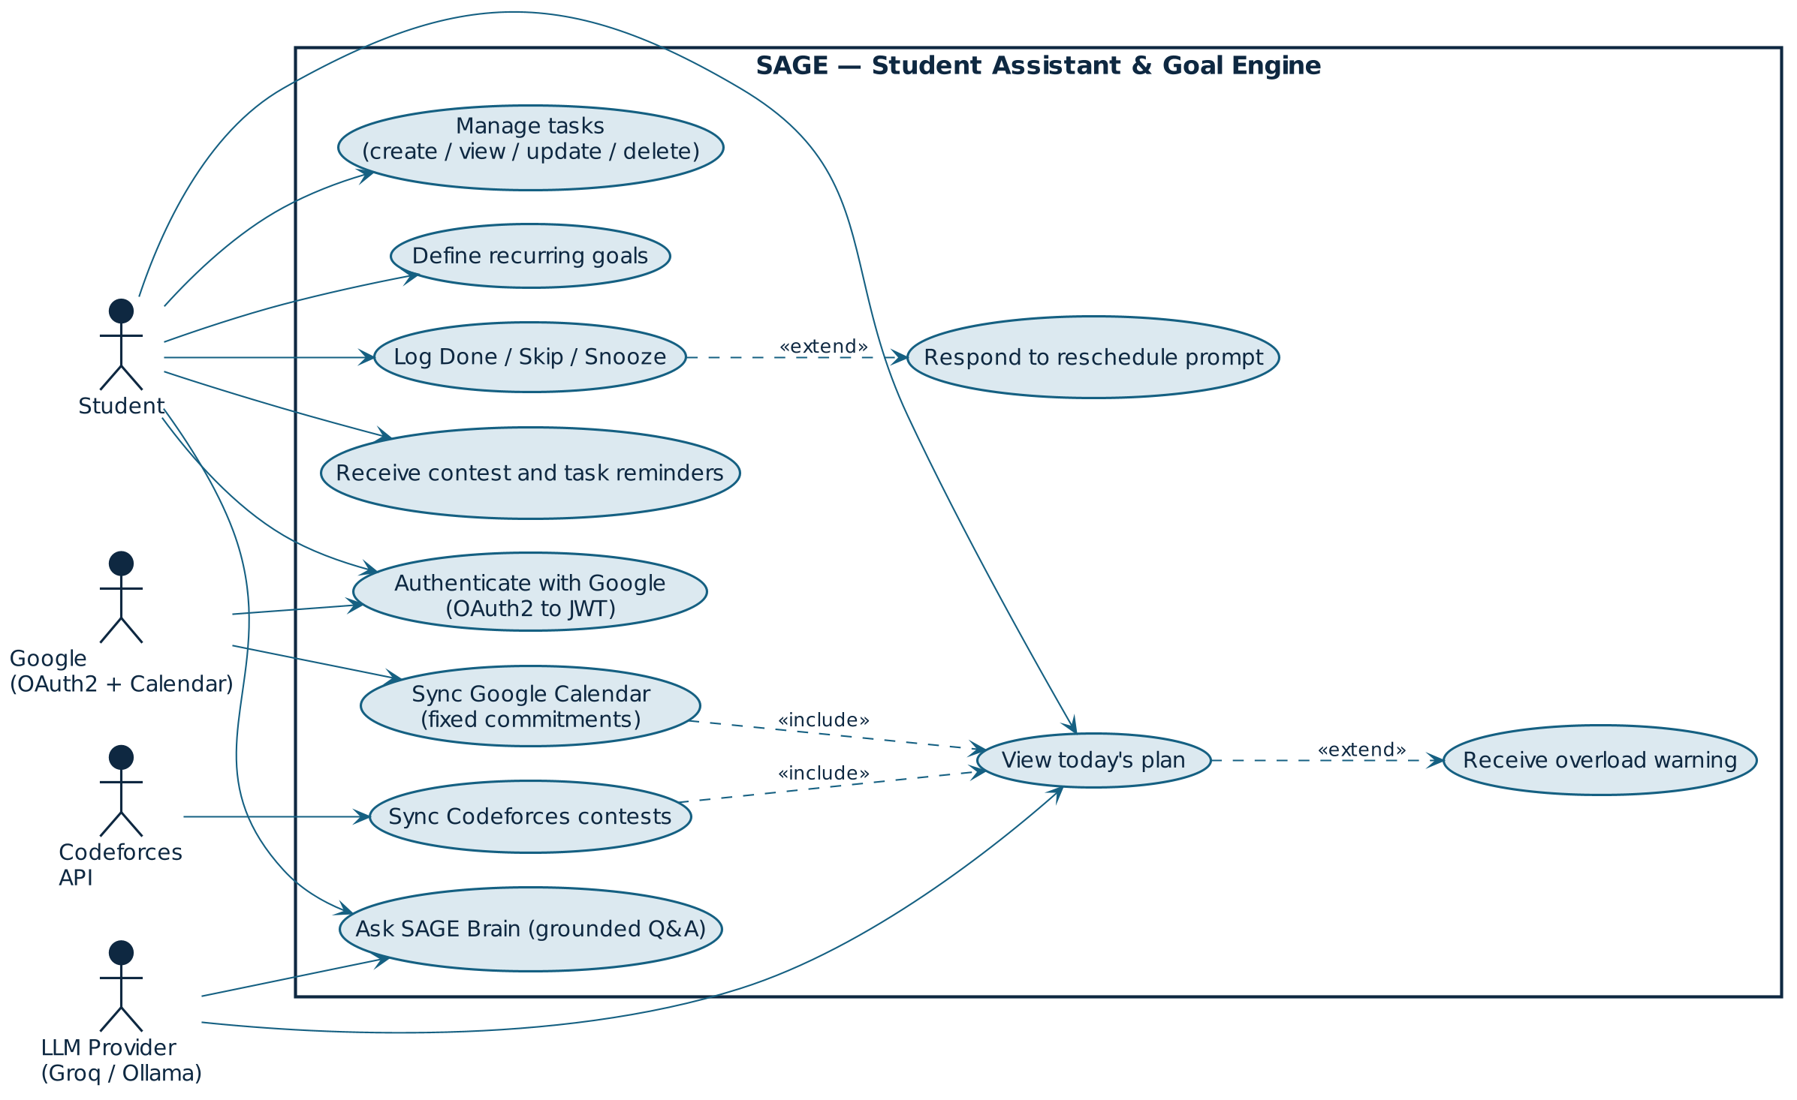
UML Use Case Diagram
Figure 3 — Use case diagram: one primary actor (Student) and three external system actors, with <<include>> and <<extend>> relationships on today's plan and the snooze loop.

Slide 16
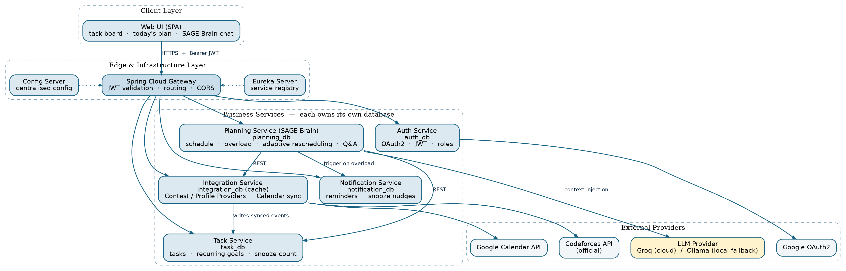
System Architecture Diagram
Figure 4 — Layered SOA: client, edge/infrastructure, five business services (one database each) and external providers. Synchronous REST only — no message broker at this request volume.

Slide 17
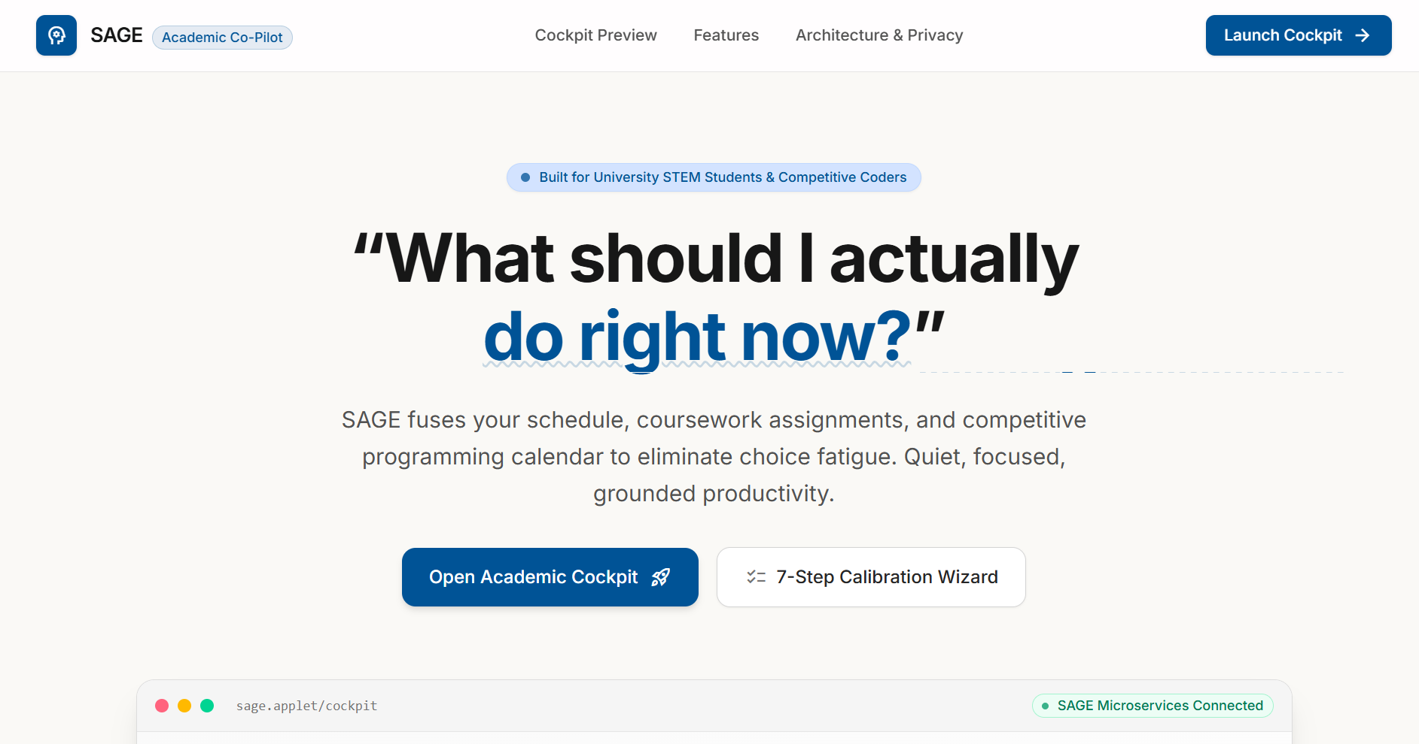
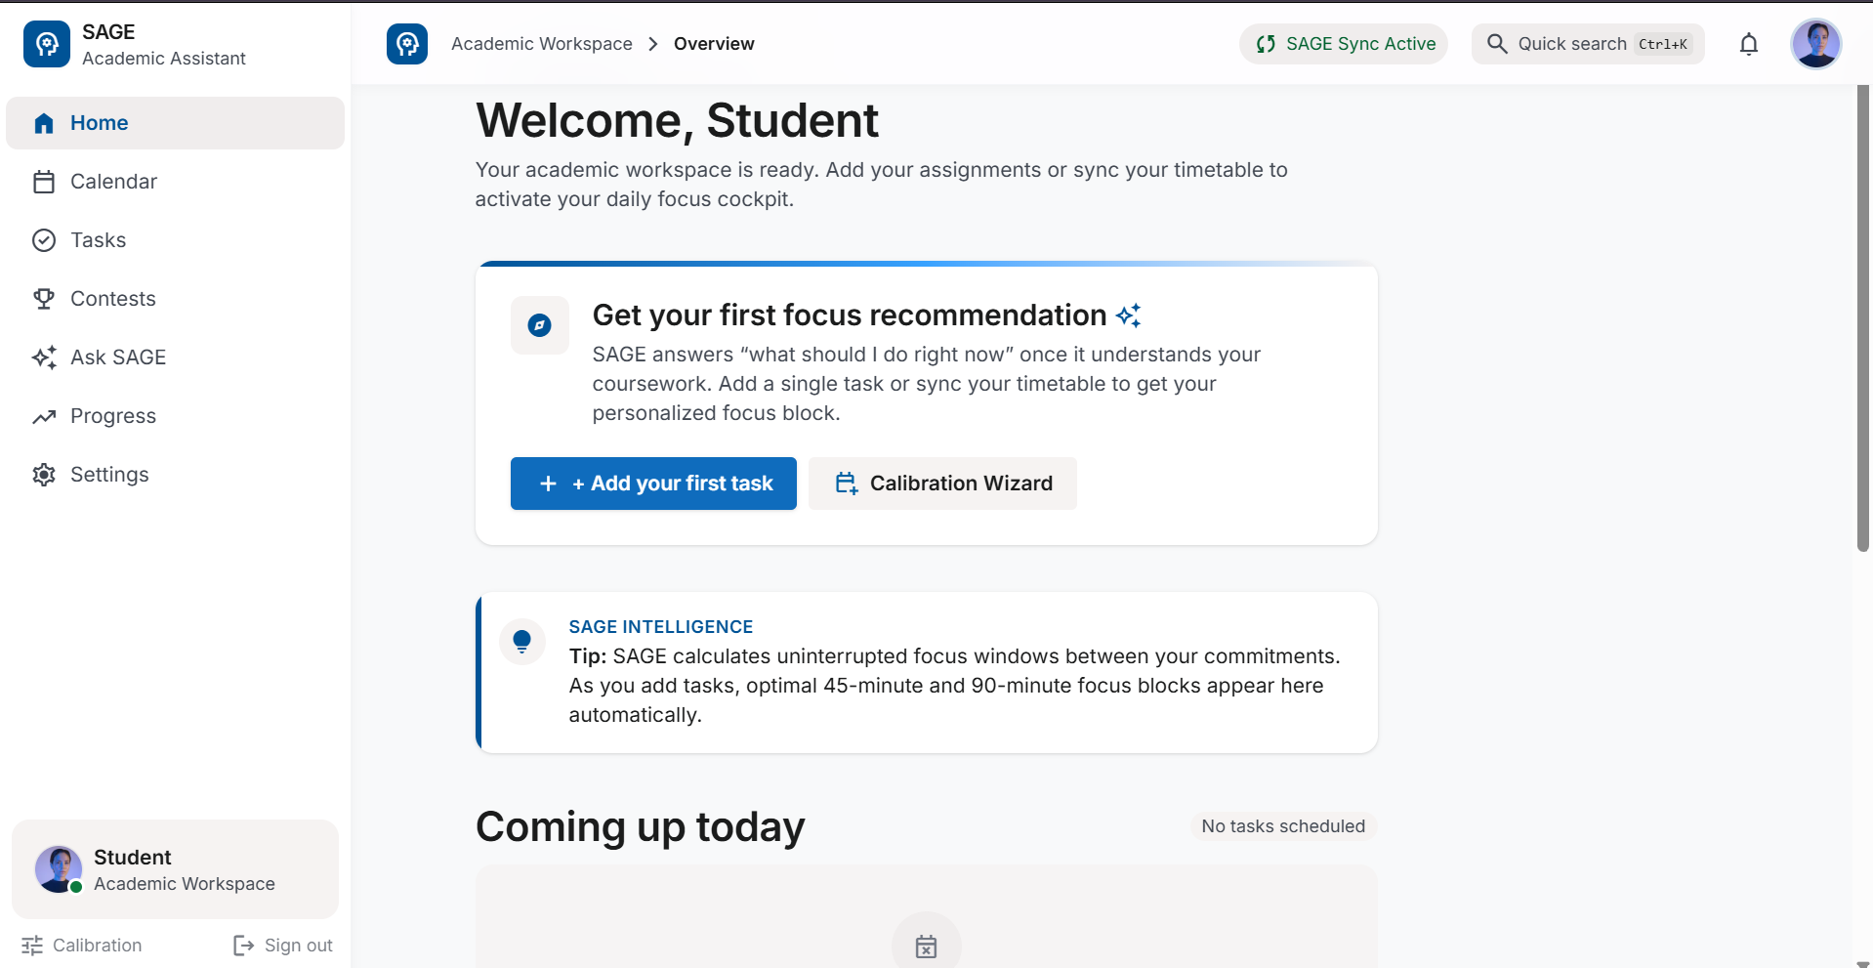
IMPLEMENTATION

Slide 18
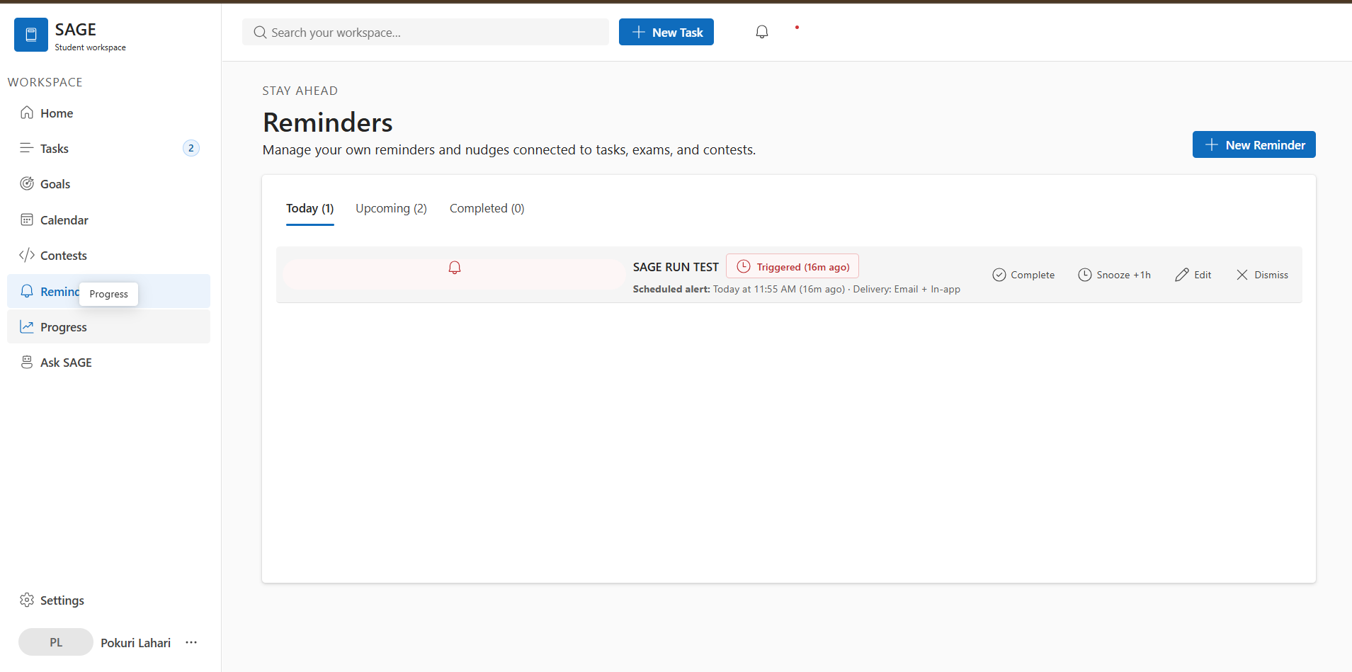
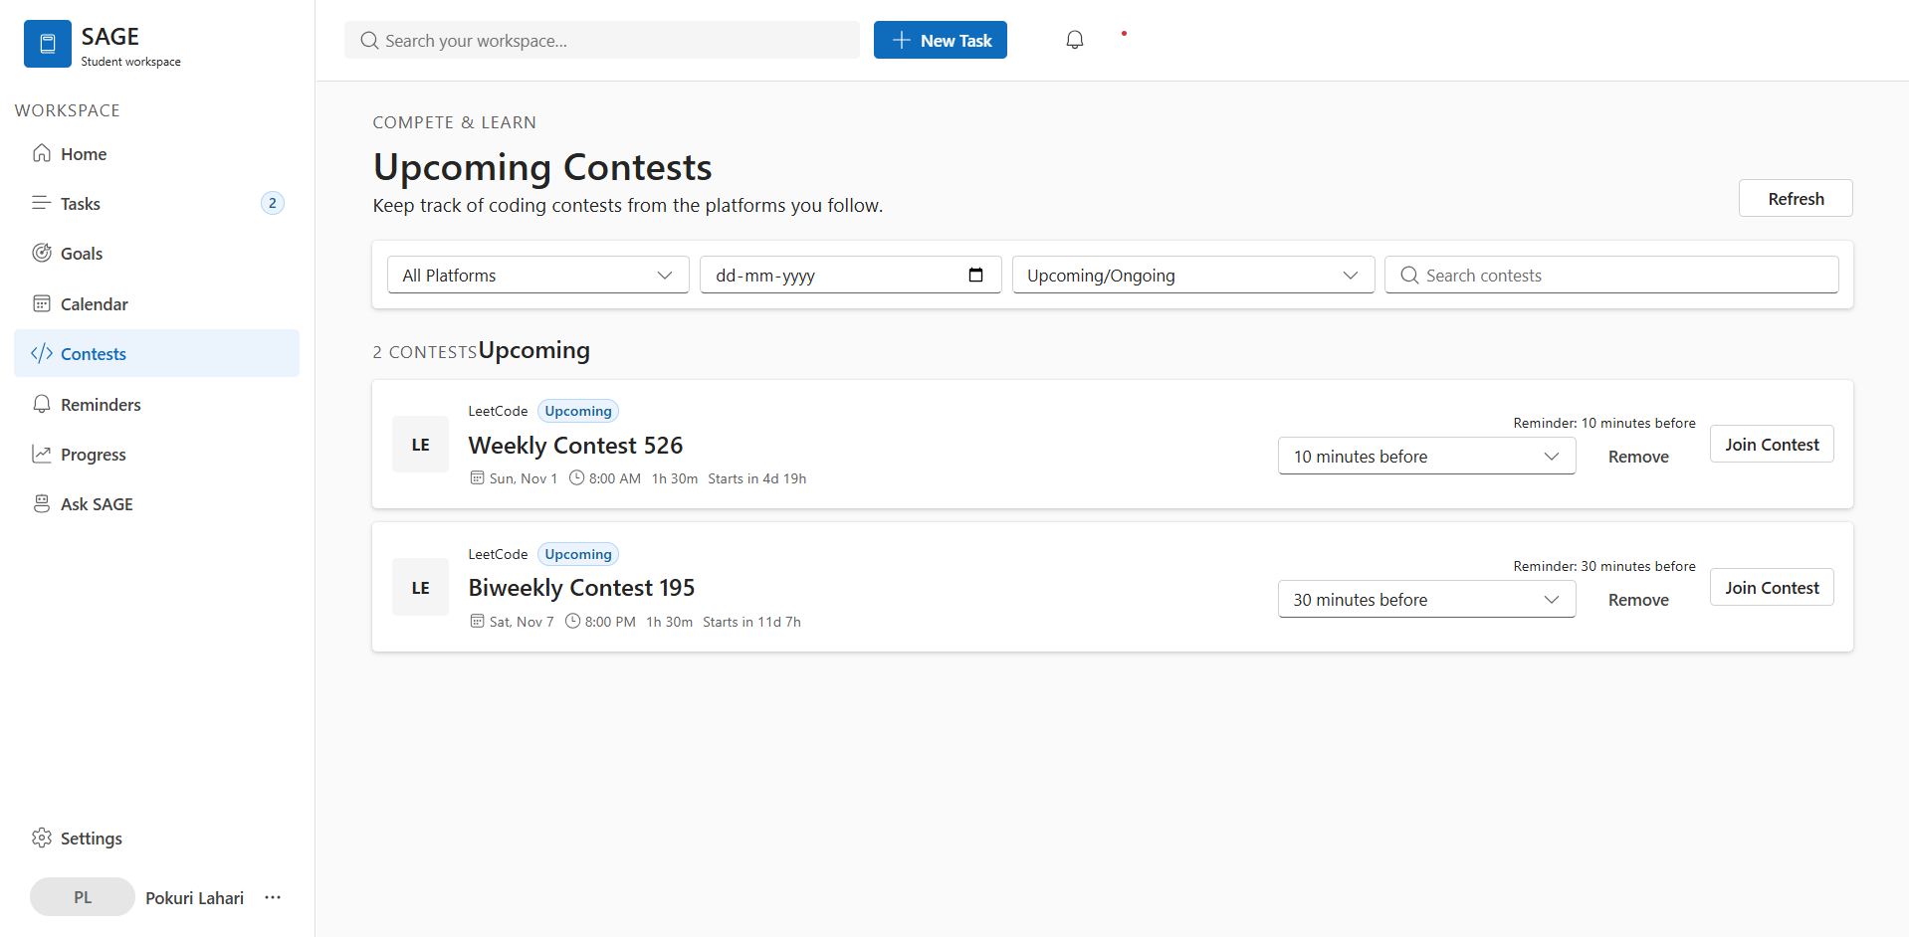
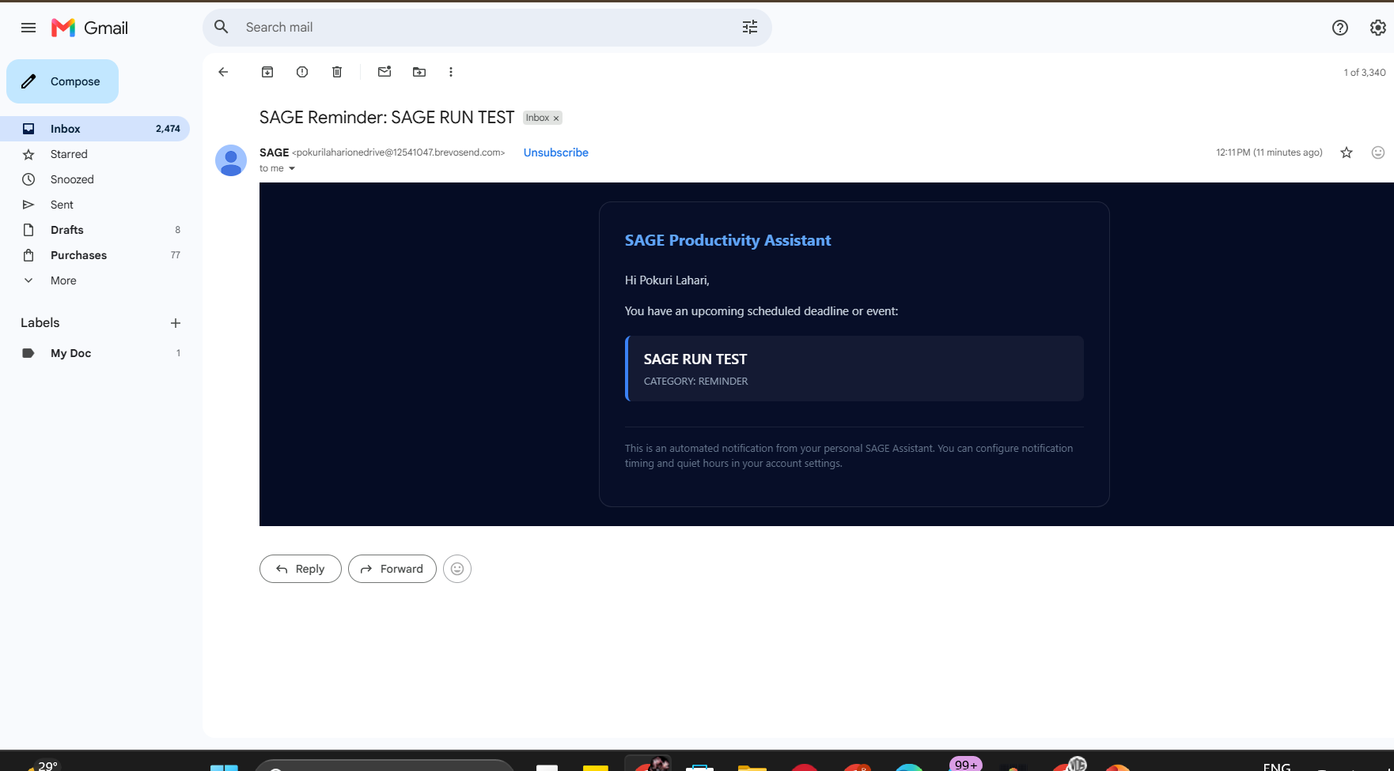
IMPLEMENTATION

Slide 19
Academic Requirement Coverage
Academic requirement | Status
At least 3 microservices (5 delivered) | Done
JWT authentication (Auth Service) | Done
Role-based authorization (Auth Service) | Done
Architecture diagram | Done — this deck
Service contracts and REST endpoints documented | Pending
CORS configuration | Pending
Eureka service registration | Pending
Spring Cloud Gateway routing | Pending
Database per service | Pending
Unit and integration tests | Pending
Postman API testing | Pending
GitHub Actions | Pending
Jira user stories and sprint board | Pending

